Slide 1
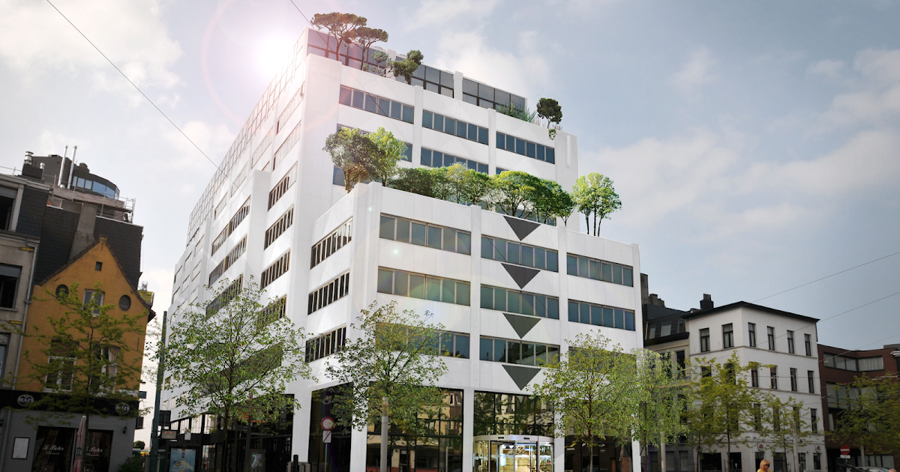


CHALLENGES of PUBLISHING IoT DATA
FLAGIS Geo Atelier
03/05/2022
Philippe Michiels

Slide 2
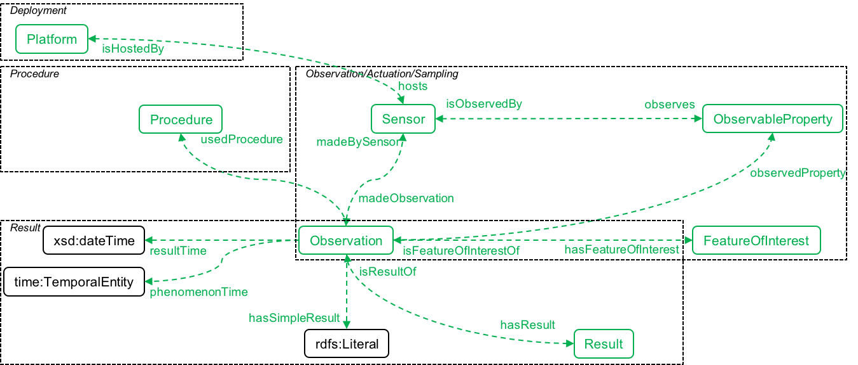
Saving measurements
SSN and SOSA
SOSA: Sensors, Observations, Actuation, Sampling (observation perspective)
Semantic Sensor Network Ontology (w3.org)

Slide 3
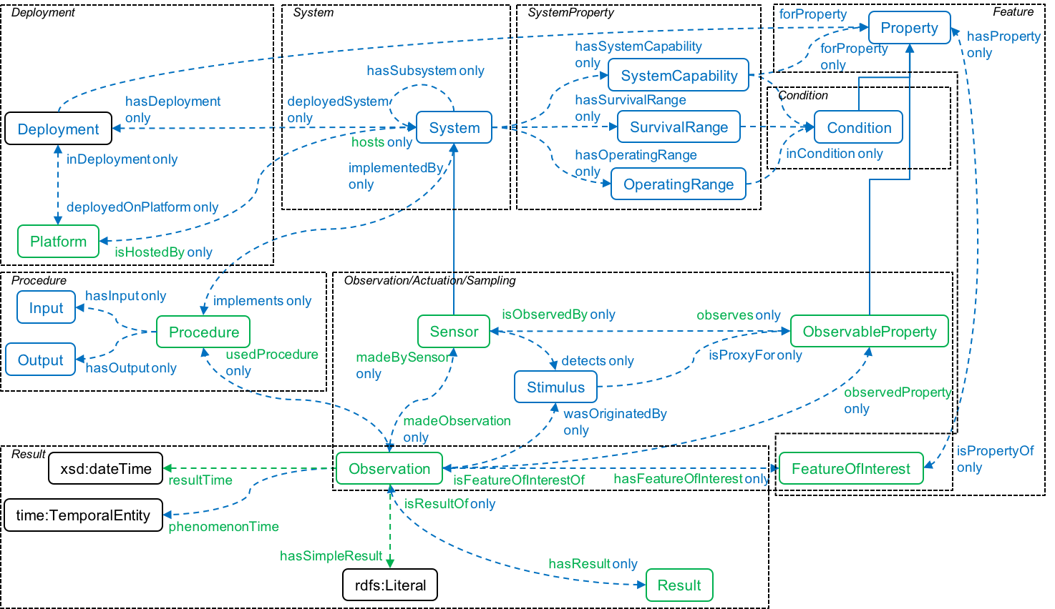
Saving measurements
SSN and SOSA
SSN: Semantic Sensor Network (observation perspective)
Semantic Sensor Network Ontology (w3.org)

Slide 4
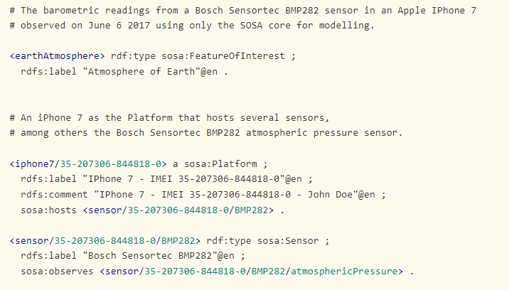
Example
iPhone Barometer

Slide 5
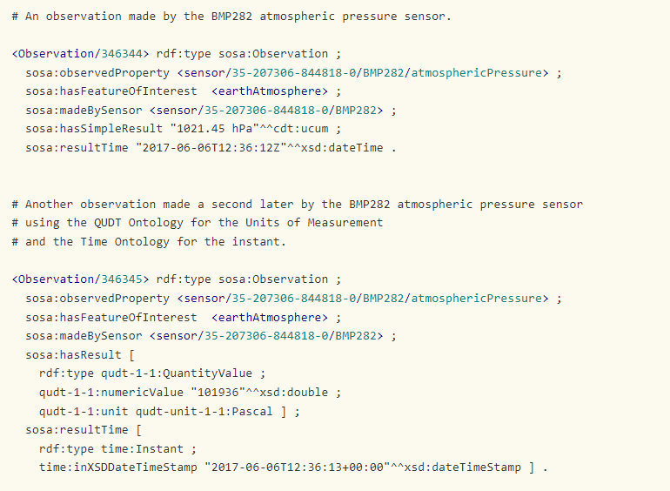
Examples
iPhone Barometer OBSERVATION

Slide 6
Context Matters
Making measurements useful
Observations may show sudden changes in atmospheric pressure
What is going on …
Did the weather change?
Did the sensor move?
Keeping track of context is important
Sensor properties may change
External factors may influence the sensor behavior (maintenance, replacement)
…
But … these are also just timeseries!

Slide 7
Challenges of IoT
Context versus measurements
maintenance logs
… Δ Δ Δ Δ …
update
Subject
pages
… Δ Δ Δ Δ …
immutable version objects
is version of
sensors
… Δ Δ Δ Δ …
observations

Slide 8
Challenges of IoT
Data storage and publishing
Storing IoT timeseries, plenty of options
MySQL database
Influx DB
…
Publishing IoT timeseries
Interface?
Scalability?
Retention?
…

Slide 9
Challenges of IoT
Maintenance & Scalability hell
Data
SPARQL
WFS
Auto-completion
App
App
App

Slide 10
Challenges of IoT
Replication Hell
Data dump
SPARQL
WFS
Auto-completion
App
App
App

Slide 11
Linked Data Event STreamS
Staying in sync
Δ
Δ
Δ
Δ
Δ
SPARQL
WFS
…
App
App
App

Slide 12
Linked Data Event STreamS
PRIORITIES OF PUBLISHING DATA
III Querying
interfaces
Data publishers focus on efficient scalable publishing, allowing consumers to stay in sync
Consumers can replicate and stay in sync efficiently via fragment-based syncing
Alternative fragmenting by publishers or intermediaries supports other use cases (e.g., time-based, geo-based, …)
Indexes can be combined/queried for use in apps without burdening the publisher
Retention at publisher side is advertised
II Reusable indexes
I Replicatie & sync
Third party indexes
Third party querying interfaces

Slide 13
Example: ADDRESS REGISTRY
https://smartdata.dev-vlaanderen.be/base/
LDES published at the source
Communities
Street names
Third party indexes on name (substring fragmentation/index)
Metadata catalog makes fragmentation discoverable
Client queries all fragments
Autocomplete demo (treecg.github.io)

Slide 14
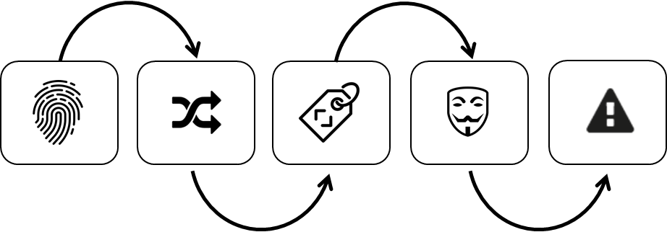
Vlaamse Smart Data Space
Leveraging smart data for sustainable growth of the Flemish data economy
Why?
4 Pillars
Data gets stuck in silos. Different kinds of lock-ins hamper innovation and business value:
Vendor lock-in,
Project lock-in,
Domein lock-in,
Technische lock-in.
Key: interoperability
New business models
VSDS Workbench
Building blocks for interoperable publishing, archiving, indexing, linking data.
standards
Ecosystem
Governance
Data publishers

Slide 15
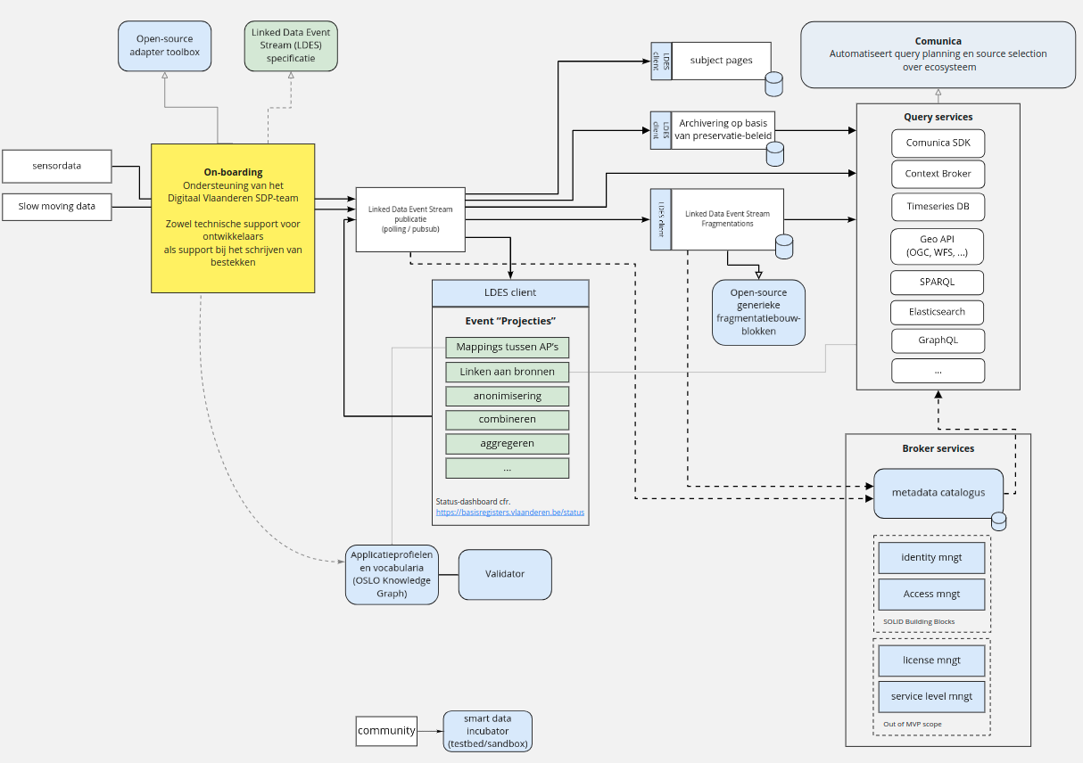
VSDS: Vlaamse smart data space

Slide 16

‘But wait, what’s a data space really about?
Building blocks and agreements
Data spaces are communities that agree on converging to using shared agreements in the form of
Meta-data publishing
Data transfer protocols & service standards
Schemas and semantics
Data licensing
Authentication and access control
Persistent identifier strategy
In addition to agreements, a data space may offer
Data publishing & processing components
Run-time environment(s) for running the components
Community support & tools for data onboarding, software contributions, service development, …

Slide 17
Data space architecture and roles (IDSA)
From exchanging data to sharing Assets
Service Provider
Transfer Data
Broker Service Provider
Receive Data
Publish Metadata
Search Metadata
Data Owner
Authorize
Data Provider
Transfer Data
Data Consumer
Use Data
Data User
Log Transaction
Log Transaction
Clearing House
Provide Vocabularies
Use Data Apps
Use Data Apps
Core Participant
Data Flow
App Provider
Publish App
APP STORE Provider
Vocabulary Provider
Intermediary
MetaData Flow
Service Provider
Software Flow
Notes:
This Gaia-X dataspace diagram shows how that could work for PILL:
The data provider publishes schedule data that is used in a schedule service. The service is used by the agent routing planner to find a reserve routes in the network.
The routing algorithm itself can be an application that is made available in the app store. Different competing algorithms can be published if desired.
Finally, a vocabulary provider (OSLO) ensures interoperability across data streams. Not just for planning a route but also for exchanging related data such as Bill of Lading data, customs data, CRMs and so on.
When such data streams result in financial costs, clearing house infrastructure can keep track of transactions.

Slide 18
Data space architecture and roles (IDSA)
Fit-for-purpose service
From exchanging data to sharing Assets
Service Provider
Transfer Data
Broker Service Provider
Receive Data
publish LDES and indexes
Publish metadata
Search Metadata
Consume LDES or service
Publish Metadata
Data Owner
Authorize
Data Provider
Transfer Data
Data Consumer
Use Data
Data User
Log Transaction
Log Transaction
Clearing House
Provide Vocabularies
Use Data Apps
Implement business models
Publisher of building blocks
Use Data Apps
Core Participant
Data Flow
App Provider
Publish App
APP STORE Provider
Vocabulary Provider
Intermediary
MetaData Flow
Reusable building blocks
Standards
(OSLO)
Service Provider
Software Flow
Notes:
This Gaia-X dataspace diagram shows how that could work for PILL:
The data provider publishes schedule data that is used in a schedule service. The service is used by the agent routing planner to find a reserve routes in the network.
The routing algorithm itself can be an application that is made available in the app store. Different competing algorithms can be published if desired.
Finally, a vocabulary provider (OSLO) ensures interoperability across data streams. Not just for planning a route but also for exchanging related data such as Bill of Lading data, customs data, CRMs and so on.
When such data streams result in financial costs, clearing house infrastructure can keep track of transactions.

Slide 19
More infoRmation
Pointer and references
Vlaamse Sensor Data Space: Vlaamse Sensor Data Space | Vlaanderen.be
Linked Data Event Streams
Specification: SEMICeu/LinkedDataEventStreams: The Linked Data Event Streams specification (github.com)
Online course: https://academy.europa.eu/courses/publishing-data-with-linked-data-event-streams-why-and-how
In-depth article: Publishing Linked Data Event Streams (thepieterdc.github.io)
Semantic Sensor Ontology: Semantic Sensor Network Ontology (w3.org)
Imec smart city whitepaper: Download white paper on Smart City and Smart Architecture | imec City of Things

Slide 20
Philippe Michiels
Philippe.michiels.ext@imec.be
Philippe Michiels | LinkedIn

